Slide 2
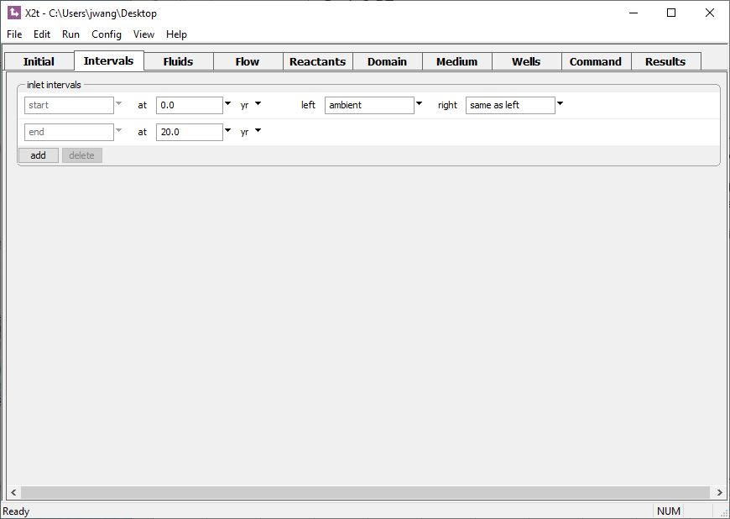
The Intervals pane sets the total duration of the simulation.
Ambient fluid will flow into the domain’s left inlet
Simulation lasts 20 years

Slide 3
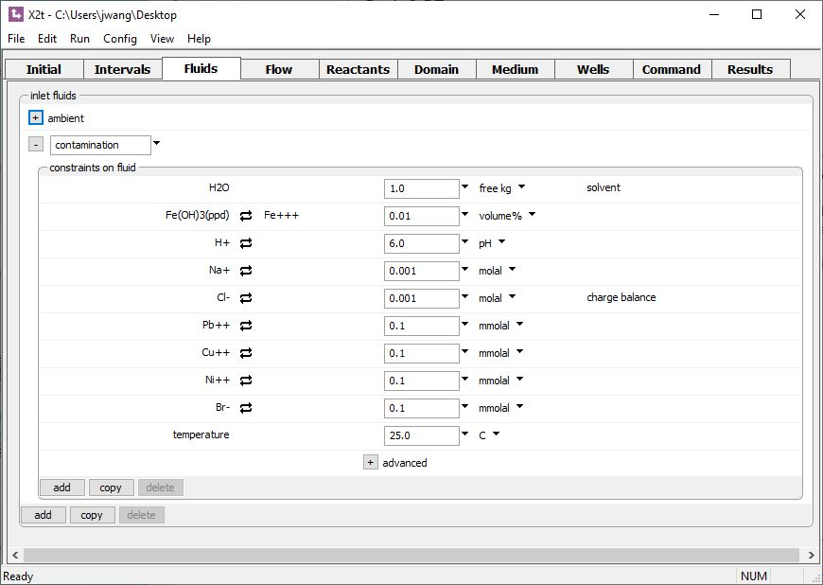
Add any injection fluids on the Fluids pane.
Clean water
Contaminated water
Click to add a new fluid

Slide 4
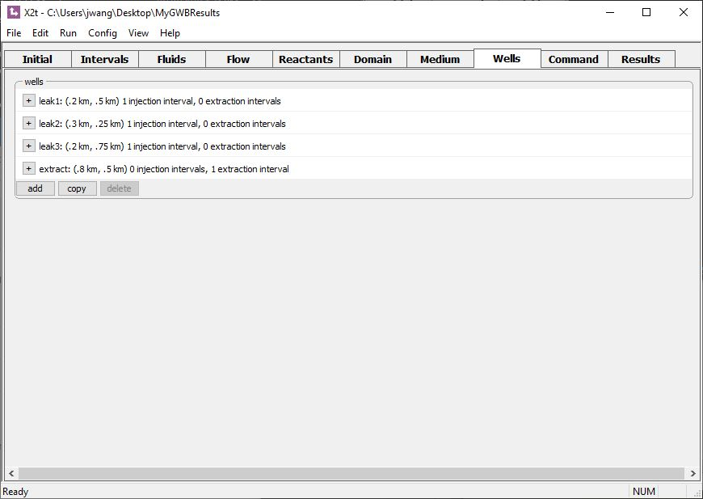
Use the Wells pane to set the name, location, chemistry(s), and flow rate(s) of wells.
Click to expand view
Click to create a new well

Slide 5
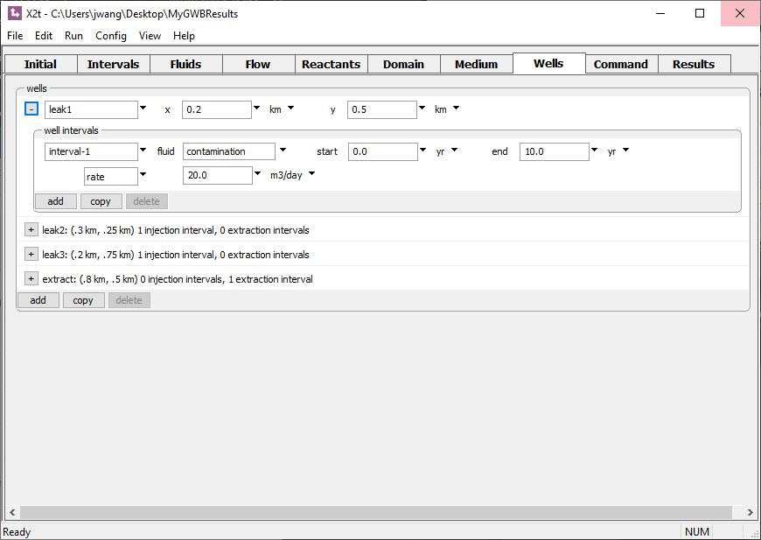
XY position
Injection fluid
Well “leak_1” injects contaminated fluid for first 10 years
Positive rate indicates injection

Slide 6
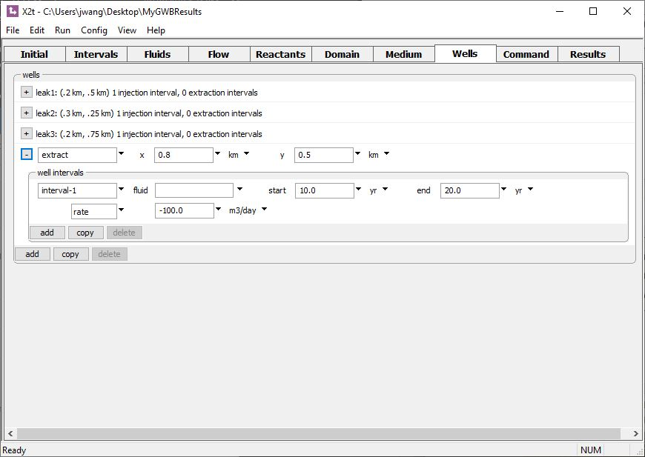
Well “extract” produces water after 10 years
Negative rate indicates withdrawal (no need to specify injection fluid)

Slide 7
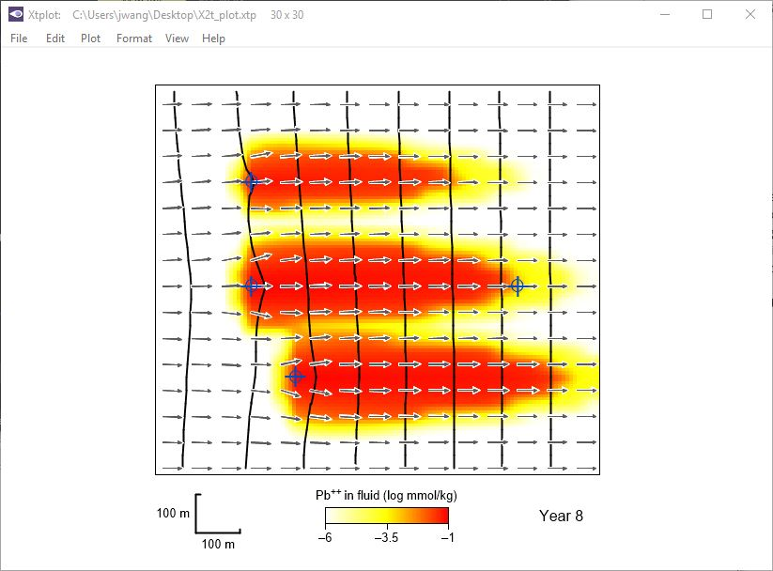
Pb⁺⁺ contaminated water enters the domain through three point sources (injection wells).
Contour lines represent hydraulic potential.

Slide 8
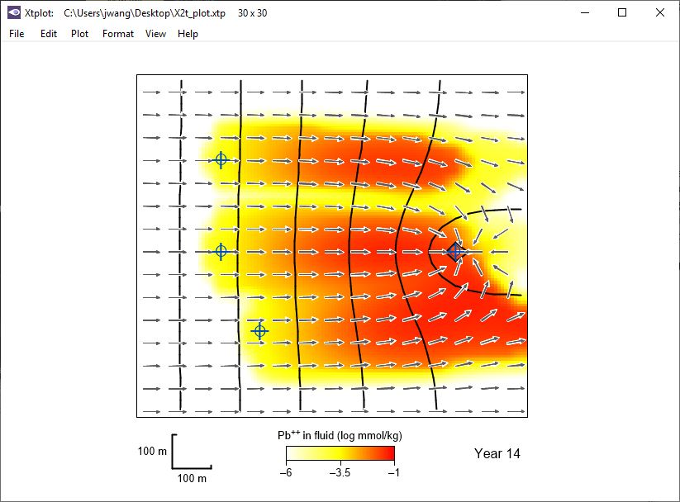
Production well draws contaminated fluid out of the aquifer.

Slide 9
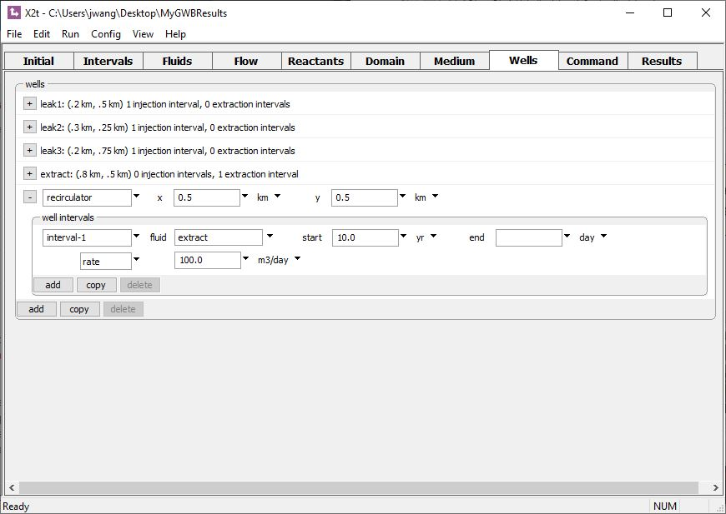
As an alternative to setting injection fluid chemistry, you can recirculate the fluid produced from any extraction well.
For the “recirculator” well, reinject whatever comes out of the “extract” well

Slide 10
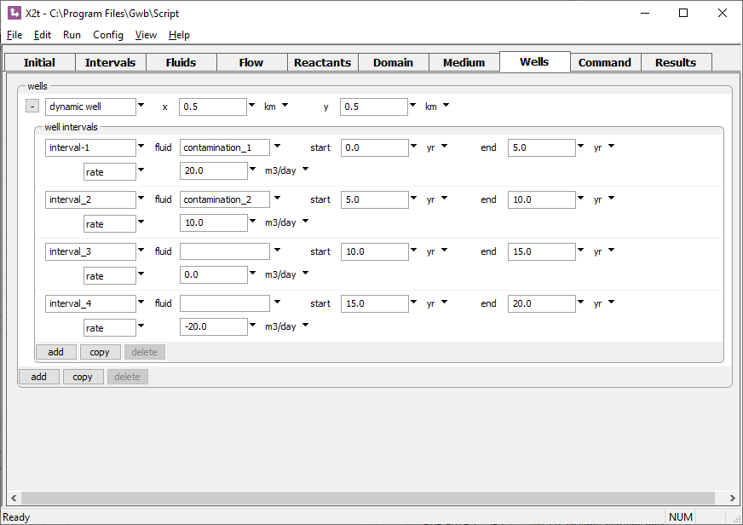
For each well, you can add any number of “well intervals”
Inject different fluids, change pumping rate, or turn well on or off over time
Click to add new well intervals

