Slide 1
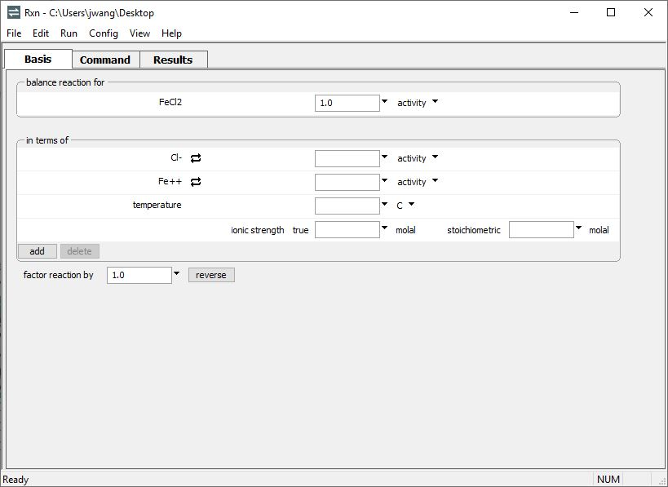
log K polynomial fit

Slide 2
Under balance reaction for, choose a species to appear on the reaction’s left side…
… then swap out the in terms of species if necessary to recast the reaction.
Run → Go
balances the reaction

Slide 3
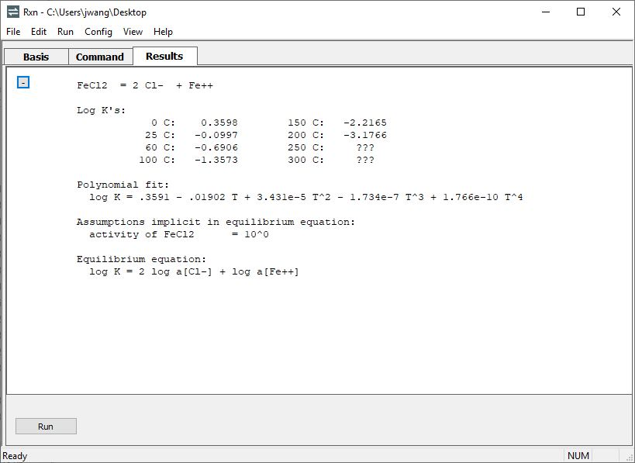
Move to the Results pane.
No thermo data available for reaction at 250, 300 °C
GWB programs fit the log Ks to a temperature polynomial (in °C) which they’ll use for interpolation.
With extrapolate option, GWB programs use the polynomial to estimate log Ks outside data range.

